Slide 1
Introduction to Simulation and Modeling
Azaz Ahmed Kiani

Slide 2
Experimental Design
(Lecture 25,26,27)

Slide 3
Introduction
Once the simulation model of the actual system has been properly validated, the practitioner can turn his or her attention to determining how to design additional models for subsequent experimental analysis.
Traditional statistical references may be used to guide this process (Montgomery, 1997; Miller et al., 1990; Hildebrand and Ott, 1991).
The choice of experimental design alternatives is dependent on the original simulation project objectives developed during the problem formulation phase.

Slide 4
Factors and Levels
In experimental design terminology, factors are the different variables thought to have an effect on the output performance of the system.
Typical examples of factors are:
• Workers who perform specific functions
• Machines that perform specific operations
• Machine capacities
• Priority sequencing policies
•Worker schedules
• Stocking levels

Slide 5
Factors and Levels
Note that it is easily possible to have several different individual factors for any of the above types of factors.
For example, if we have an airport security checkpoint system, there are three different types of resource factors.
These include:
• Ticket checkers
• Metal detectors/operators
• X-ray machines/operators

Slide 6
Factors and Levels
The corresponding examples of levels for the above factors are:
• Four vs. five vs. six workers performing a specific function
• An old vs. a new machine performing specific operations
• A 5-ton vs. a 2-ton capacity truck
• First-in–first-out vs. last-in–first-out priority sequence policies
• Five 8-h shifts vs. four 10-h shifts
• Restocking order levels between 10 and 25%

Slide 7
Factors and Levels
Note that in the above examples the number of different levels for a given factor can vary.
Consider the case of the level of workers for a particular operation factor. We could be interested in the effects of:
•Four vs. five workers
•Four vs. six workers
• Five vs. six workers
• Four vs. five vs. six workers

Slide 8
Factors and Levels
Our experiment could be a simple comparison of any of the two-level alternative combinations, or it could be the more complex alternative involving the three-level alternative.
The experimental design alternatives can be classified as either simple two-alternative designs or more than two alternative designs.

Slide 9
Two Alternative Experimental Designs
In the simplest experimental design, the practitioner will have only two models to analyze. We can have two situations with this type of design:
• A base system exists
• No base system exists

Slide 10
Existing System
If the actual system is currently in existence, the corresponding model will obviously be one of the other alternatives.
The other alternatives could be based on:
• An alternative operating policy
•An alternative resource policy

Slide 11
Operating Policy with Existing System
Suppose our base model consists of three parallel queue clerk systems in a customer service center. This system has:
• Three clerks
• Three parallel queues
If we varied only the operating policy, the alternative (first alternative) might be:
• Three clerks
• A single snake queue
Any difference in the performance between the two models will be a result of the difference in the queue operating policy.

Slide 12
Operating Policy with Existing System
Another way that the operating policy could be changed is with the presence of express queues.
In this case, our operating policy change alternative model (alternative two) would consist of the following arrangement:
• Two clerks with regular parallel queues
• One clerk with an express queue
Here, we are not altering the physical layout of the queues. We are, however, restricting the type of customer who can enter the queue. Obviously, our alternative model could also have contained:
• Two clerks with express parallel queues
• One clerk with a regular queue

Slide 13
Operating Policy with Existing System
Which of these two alternative models would be better to use is a question that must be left to the analysis phase of the project.

Slide 14
Resource Policy with Existing System
On the other hand, if we decided to alter the resource level, the original system would still consist of:
• Three clerks
• Three parallel queues
However, the alternative might consist of the following components:
•Four clerks
• Four parallel queues
Here the difference between the two models will be a result only of changing the level of the clerk resource levels.

Slide 15
Both Operating Policy and Resource Levels
It is possible to create an alternative model with both operating policies and resource capacitity factors at different levels.
This means that any number of operating policies or resource capacity levels could be different. Our original model is still:
• Three clerks
• Three parallel queues
However, this now means that one possible alternative model from our original base model could be:
•Four clerks
• A single snake queue

Slide 16
Both Operating Policy and Resource Levels
Another example of this would be the alternative with the following components.
• Two clerks with a single express line
• Two clerks with a parallel regular lines
If we take this kind of mixed factor and level approach with only one alternative, the only thing that we will know is that the alternative may or may not perform differently from the base model.
Obviously, this sort of approach should be discouraged.

Slide 17
No Existing System
In the case where the system does not exist, the practitioner must still start from somewhere. Here, the two different models could also differ with respect to operating or resource policies.
Typical examples where the system may not exist include:
• Equipment for a new process from two different manufacturers
• Facility layout for a service facility for two different layouts
The same factor and level dangers are present when one is modeling nonexisting systems.
The danger might actually be greater because even less is known about the alternative models in comparison to situations where at least one base model already exists.

Slide 18
Statistical Analysis of Two Alternative Systems
In any two-alternative comparison, the statistical comparison techniques are relatively simple. These comparisons primarily involve some sort of t-test or rank sum test.

Slide 19
One-Factor Experimental Designs
Here we have one specific factor that we are going to examine at three or more levels.
The actual number of alternatives that we will have is simply the number of levels in the one factor.
From our previous example, we can decide to utilize a one-factor experimental design. If we select the number of clerks as our factor, our three different level alternatives could be:
• Three clerks
•Four clerks
• Five clerks
In the one-factor experimental design, we are not limited to the use of only three different levels, we can, in fact, use as many as we are interested in.

Slide 20
One-Factor Experimental Designs
We could also use an operating policy factor for our one-factor experimental design.
Here we fix our number of clerks and vary our queue operating policy.
Three different one-factor model alternatives could be:
• Three individual parallel clerk queues
• One single snake queue feeding two clerks and one queue feeding one clerk
• One single snake queue feeding into all three clerks
Any differences in the performance of these models would be attributable only to the difference in queue operating policy.

Slide 21
One-Factor Experimental Designs
We could also evaluate the effects of having express queues. Unlike our two alternative experimental designs, we can look at the effects of as many combinations as we like at one time.
This means that we can have:
Three clerks with three regular parallel queues
Two clerks with regular parallel queues, one clerk with an express queue
One clerk with a regular parallel queue and two clerks with express parallel queues

Slide 22
Two-Factor Experimental Designs
In this type of design, we are selecting two particular factors and will be examining each of these factors at a number of different levels.
In this case, if we had a factor A and a factor B, the number of model alternatives that we would be generating would be easily calculated by:
Number of levels in factor A × number of levels in factor B
Continuing with our examples, we could have two-factor models with:
• Two different operating policies
• Two different resource policies

Slide 23
Two-Factor Operating Policy Designs
In a two-factor operating policy design, we need to have two separate operating policies that can be varied at the same time.
With queue operating policies, our first factor can be the type of queue — parallel or single.
Our second factor can be type of customer queue entry policy — regular or express.
Three clerks with regular parallel queues
Three clerks with a single queue
Two clerks with regular parallel queues and one clerk with a single express queue
Two clerks with a single regular queue and one clerk with a single express queue

Slide 24
Two-Factor Resource Policy Design
we need to have two separate resource policies that can be varied at the same time.
The obvious choice for the first resource policy is to vary the number of resources in the system.
A less obvious choice for the resource policy is to use resources that are more or less capable than the normal resource.
Continuing with our example, we could end up with the following set of alternatives:
• Three regular clerks with parallel queues
• Four regular clerks with parallel queues
• Three novice clerks with parallel queues
• Four novice clerks with parallel queues

Slide 25

Multifactor Experimental Designs
We are now ready to move on to a much more complicated type of experiment.
Here we have multiple factors and multiple levels.
Assuming that we have the same number of levels for each factor, the equation for calculating the number of alternatives is

Slide 26

Multifactor Experimental Designs
For example, an analysis of the resource allocation of an airport security checkpoint system would involve the number of metal detectors/operators, x-ray machines/operators, and ticket checkers.
In a small airport, the effects of 1 and 4 personnel might be examined for each component in the system.
This type of experiment would result in

Slide 27
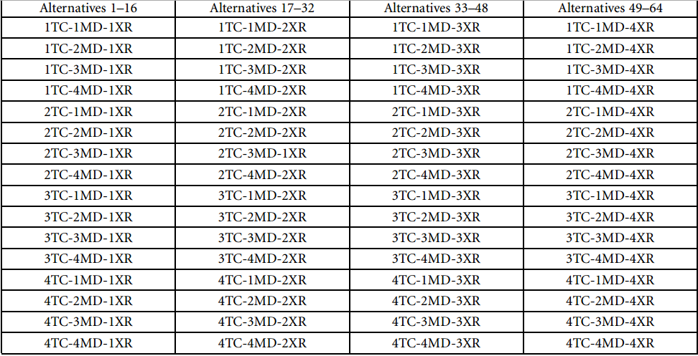
Multifactor Experimental Designs
TC = ticket checkers
MD = metal detectors/operators
XR = x-ray machines/operators

Slide 28
Reducing the Number of Alternatives by Limiting the Number of Factors
To reduce the number of alternatives and corresponding models to a reasonable number, the practitioner has a few choices.
The first choice is to reduce the number of factors. In our example, if we ignored the possible effects of the number of ticket checkers, we would have only two factors to contend with.
This would result in four raised to the second power, or only 16 different alternatives and models.

Slide 29
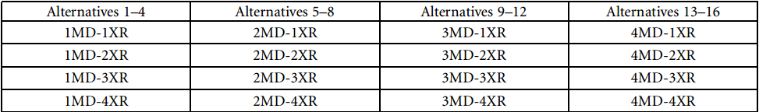
Reducing the Number of Alternatives by Limiting the Number of Factors

Slide 30
Reducing the Number of Alternatives by Reducing the Number of Levels
Another option for the practitioner is to limit the number of differen levels for each factor.
The disadvantage to this approach is that the practitioner must carefully select the appropriate levels to examine.
In our security checkpoint system example, this approach would result in the three factors examined at fewer than four different levels.
It may be realistic to assume that at least two personnel must man each of the system components at a given time.
This would mean that the experiment could be reduced to three levels with two, three, or four personnel at each component. A total of three raised to the third power, or 27, alternatives would be needed with this approach.

Slide 31
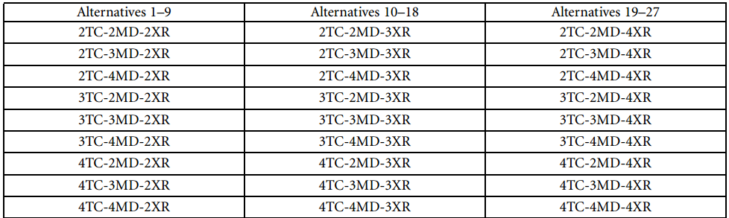
Reducing the Number of Alternatives by Reducing the Number of Levels

Slide 32
2k Experimental Designs (raised to the k power)
Yet another commonly accepted means of reducing the number of alternatives is to reduce the number of levels in each factor to two.
These levels are referred to as the low level and the high level. The use of only two levels results in 2 raised to the number of factor alternatives.

Slide 33
2k Experimental Designs (raised to the k power)
In determining the alternatives for a 2k experimental design, the concept of a binary tree can be used.
This consists of a series of branches progressing from left to right.
Two branches are in each set of the series.
The first level will have a minus and a plus branch.
The second level will have a minus and a plus branch for the first level minus branch.
Similarly, the second level will also have a minus and a plus branch from the first level plus branch.
This means that the second level will have a total of four branches.
The third level will have a minus and a plus branch coming out of each of the four branches from the second level for a total of eight different branches.

Slide 34

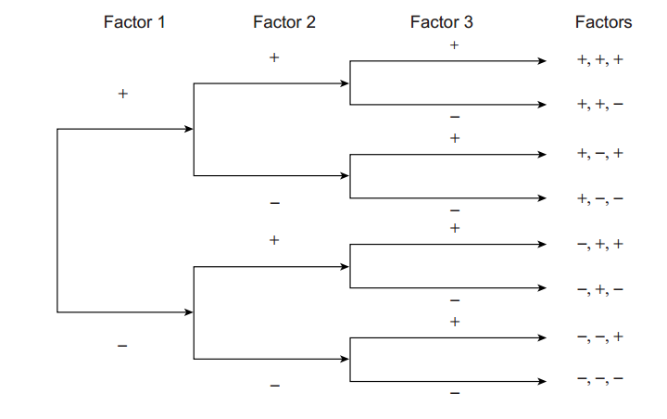
2k Experimental Designs (raised to the k power)

Slide 35
2k Experimental Designs (raised to the k power)
In our example, we would next examine the same three factors, but only at two levels.
This would result in two raised to the third power, or eight different alternatives.
These alternatives are summarized in the table below:

Slide 36
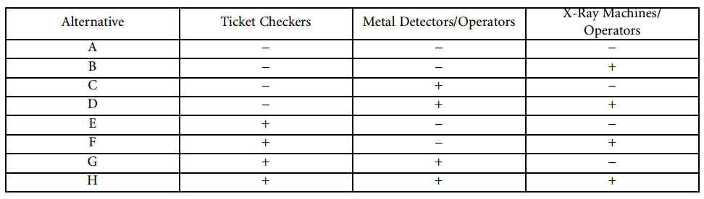
2k Experimental Designs (raised to the k power)

Slide 37
2k Experimental Designs (raised to the k power)
Once the 2k experimental design alternatives are established, the practitioner must decide on the values for the low and high levels.
For the purposes of our example, let us assume that we are interested in two to three ticket checkers, one to two metal detectors, and one to two x-ray machines.
The resulting factor levels are illustrated in the following table.

Slide 38
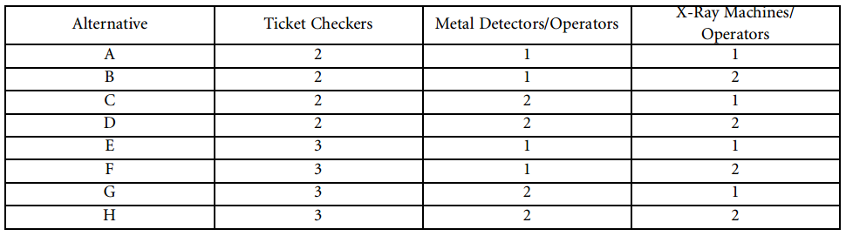
2k Experimental Designs (raised to the k power)

Slide 39
2k Experimental Designs (raised to the k power)
The assignment of these values actually does not need to be consecutive. In other words, we do not necessarily need to examine the difference between the effects of 2 and 3 or 3 and 4 personnel assigned to each part of the security checkpoint.
We could very well examine the effects between 2 and 4 personnel.
A nonconsecutive level experiment might have the following low and high levels.

Slide 40
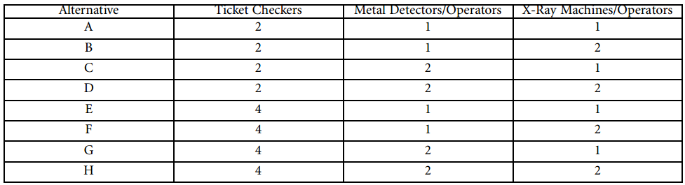
2k Experimental Designs (raised to the k power)

Slide 41
Refining the Experimental Alternatives
In some instances, the initial experiment is primarily conducted to gain a feel for the performance of each of the factors that are thought to have an impact on the output measures of performance.
There is no expectation that the simulation study will be limited to the initial set of factors or levels.
In these circumstances, follow-up experiments are conducted that focus on the factors that were determined to be significant at the previous levels.
If substantially different low and high values were used, it may be necessary to run several sets of experiments in order to bracket the point at which the levels in the factor become significant.

Slide 42
Summary
Any Questions?

